Slide 1
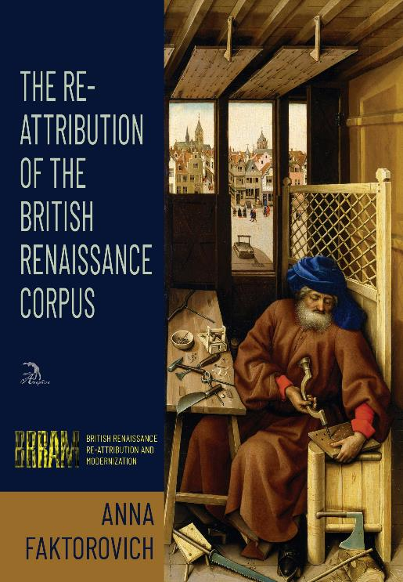
British Renaissance Re-Attribution and Modernization Series
By: Anna Faktorovich, PhD
https://anaphoraliterary.com/attribution
Anna Faktorovich, PhD, is an English professor, Director of Anaphora Literary Press, and the author of scholarly books including Rebellion as Genre and Formulas of Popular Fiction. Her fragments out of BRRAM have been published in scholarly journals including Critical Survey, East-West Cultural Passage and the Journal of Information Ethics.

Slide 2
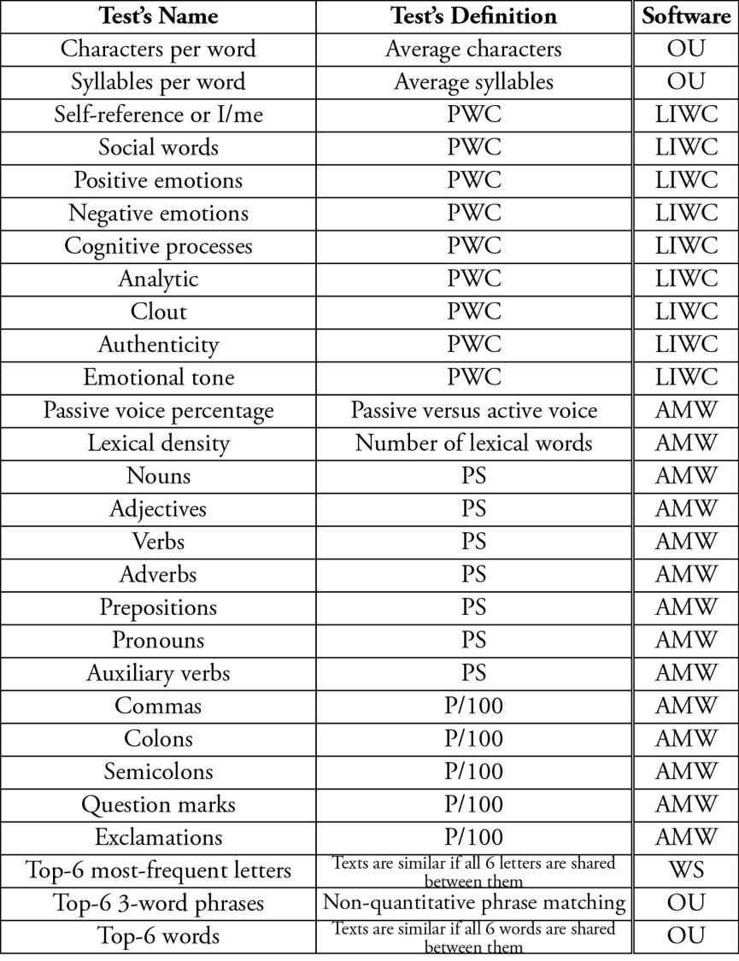
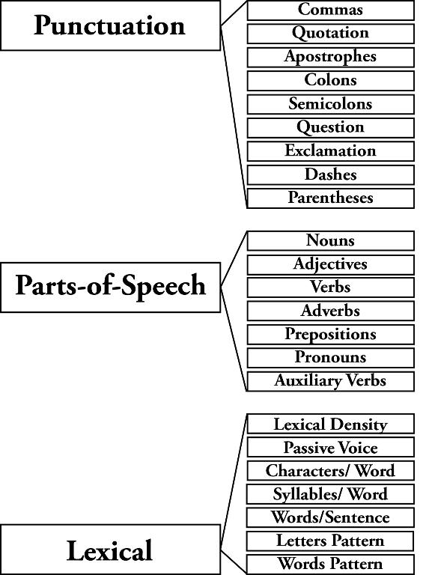
Computational Linguistic Tests

Slide 3
23-Tests Method: Steps
1. Find a group of texts from a given period that are connected to an authorial mystery you want to solve, and save them as .doc/x and .txt document versions. Cut out fragments from other bylines.
2. Open free publicly-accessible websites—www.analyzemywriting.com, https://www.online-utility.org/english/readability_test_and_improve.jsp, and https://www.online-utility.org/text/analyzer.jsp. And download the free version of the WordSmith program.
3. Enter each of the texts separately into each of these platforms and record the data for several linguistic tests into a spreadsheet. Renaissance corpus: 23 tests for: punctuation, lexical density, parts of speech, passive voice, characters and syllables per word, and patterns of the top-6 words and letters. Additional tests can be added for psychological word-choice, as they were in the Renaissance corpus for a 27-tests total. Your first column should be the titles of all texts in the group, and the top row should be the names of the different tests applied to them. You will want to create duplicates of this raw data in separate tabs in the spreadsheet, with one sheet for each text in the group.
4. In the spreadsheet, organize the numbers for each of the tests from-smallest-to-largest, and mark only the texts that are with 17-18% of the compared text on this spectrum. For example, if you are only testing 20 texts, you can select 2 texts just above and 2 more just below your compared-against text’s value and change their numbers to 1, while changing all of the other numbers to 0; the 1 means the texts are similar, while the 0 means they are different.
5. When you have changed the entire sheet’s data into 0s and 1s, create a last column and automatically add up the Sum for each row.
6. Evaluate your results to determine what number in the sum column means two texts are by the same author, or if they were written by two or more authors, or if they were written by different authors. You will have to create a cut-off point for the number of matches that separate similar from divergent texts in your chosen set of texts.

Slide 4
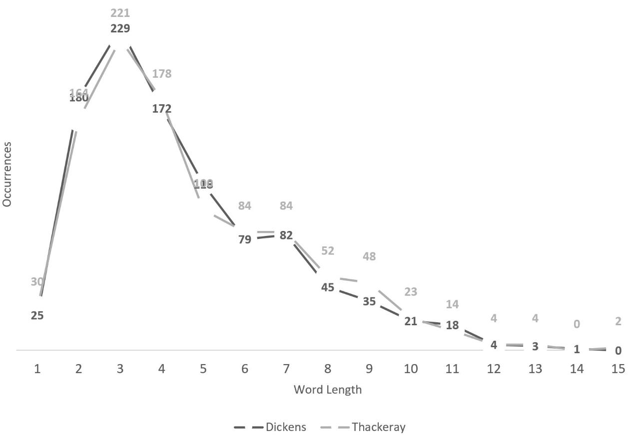
Curve for First 1,000 Words from Group-G: Thackeray’s Vanity Fair vs Dickens’ Tale of Two Cities.

Slide 5
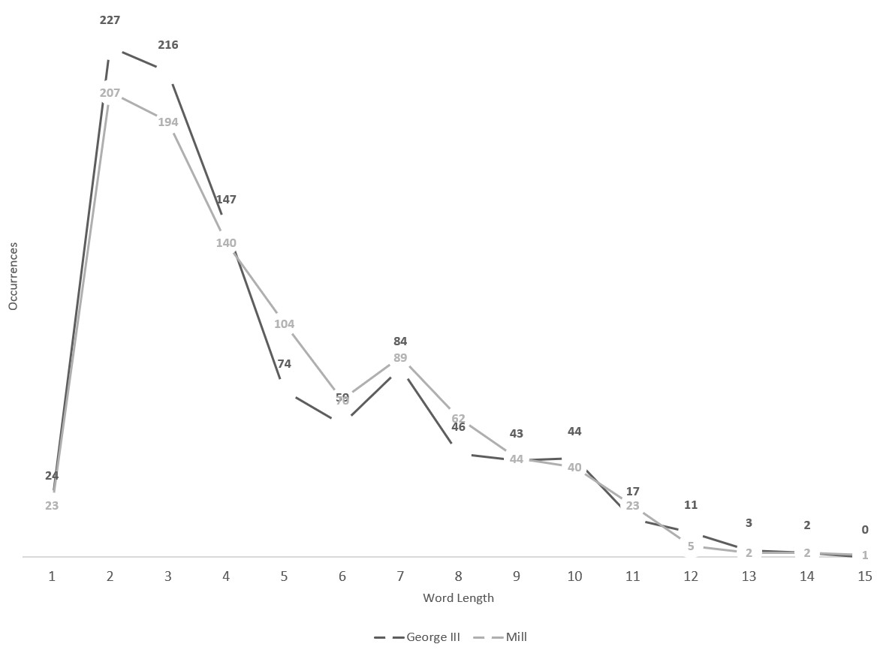
Curve for First 1,000 Words from Group-I: King George III’s Letters vs Mill’s Utilitarianism.

Slide 6
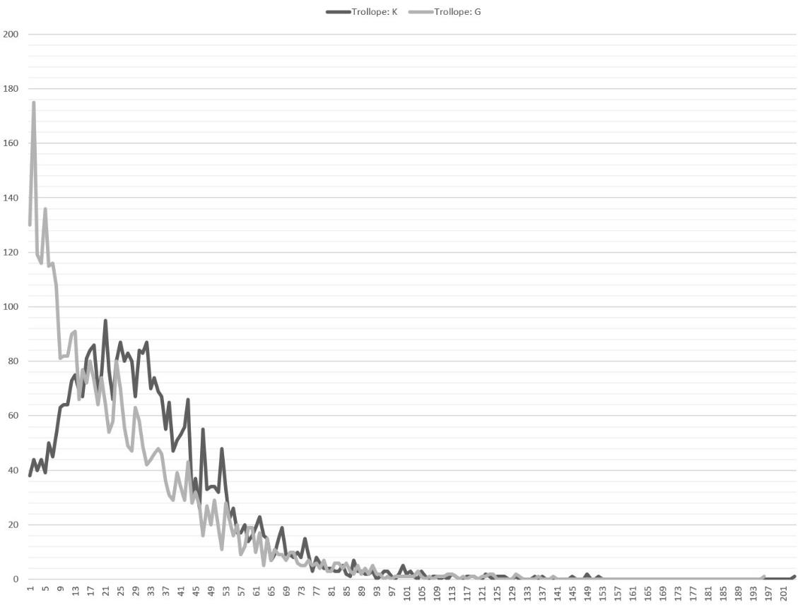
Comparison on Word-per-Sentence Length of 1 Byline in 2 Linguistic Groups: Group K: Frances Milton Trollope’s Domestic Manners; Group G: Trollope’s Vicar of Wrexhill.

Slide 7
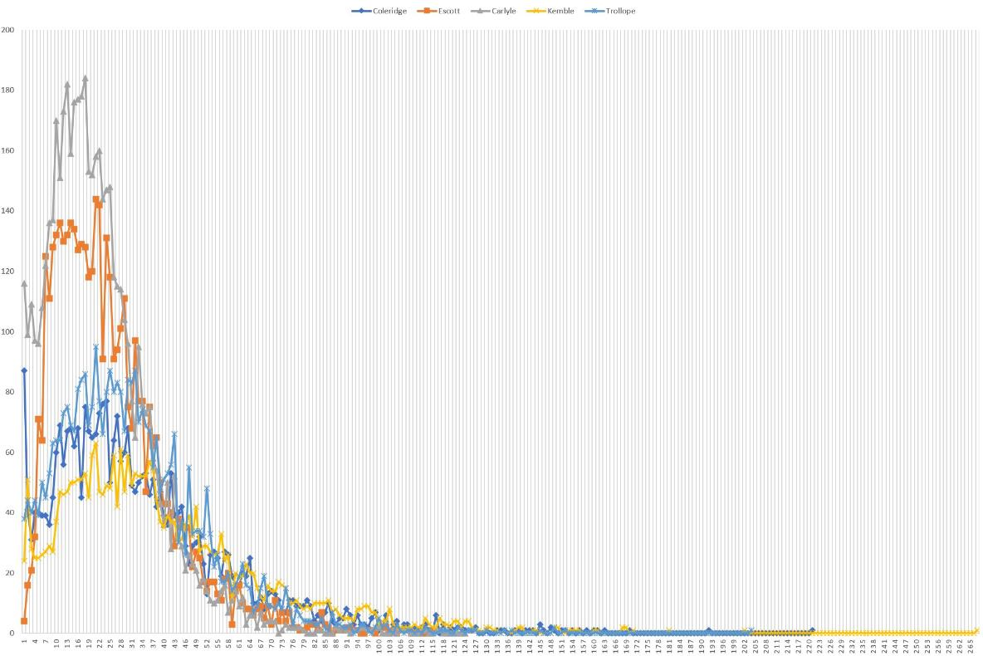
Comparison on Word-per-Sentence Length of 5 Bylines in 2 Linguistic Groups: Group I: Thomas Hay Sweet Escott’s Social Transformations and Thomas Carlyle’s French Revolution; Group K: Samuel Taylor Coleridge’s Biographia Literaria, Frances Milton Trollope’s Domestic Manners and Fanny Kemble’s Journal of a Residence.

Slide 8
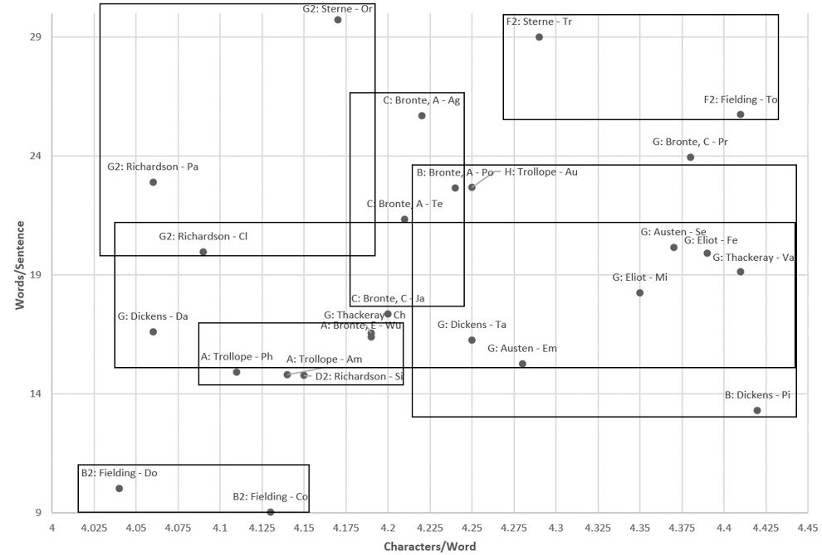
Characters/Word versus Words/Sentence: 19th Century: “Brontes”, “Austen”, “Dickens”, “Eliot”, “Thackeray” and “Trollope”; 18th: “Fielding”, “Richardson” and “Sterne”

Slide 9
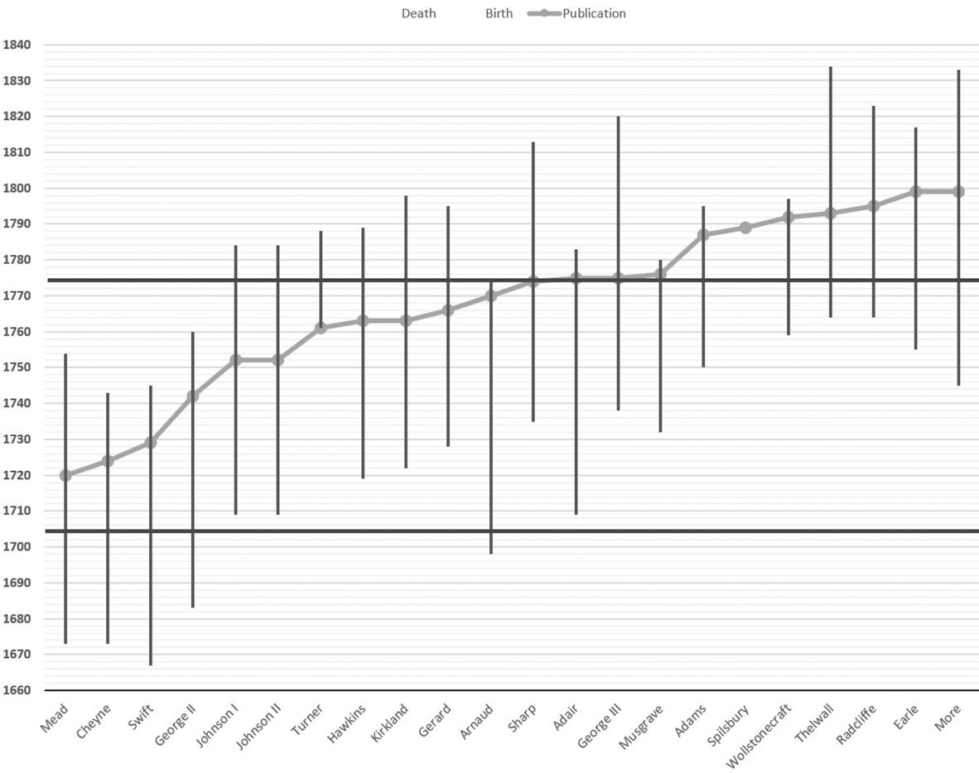
18th Century’s Group-A by Birth, Death and Publication Years

Slide 10
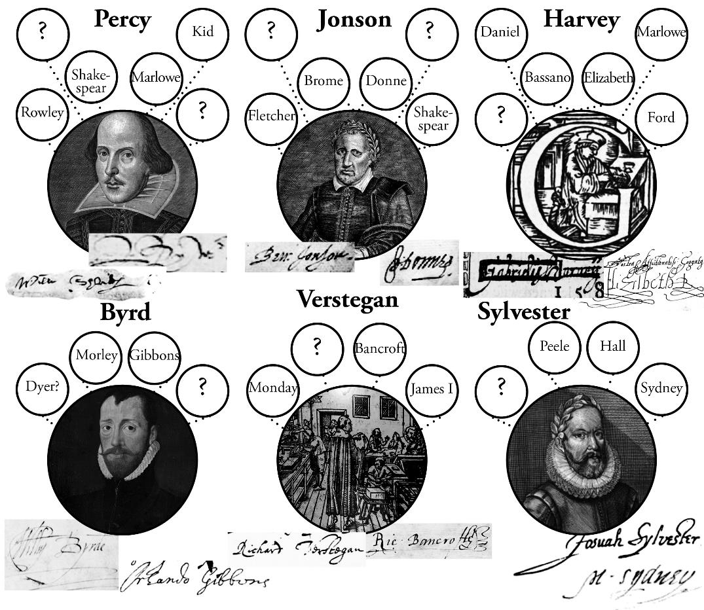
Six Linguistic Clusters in the Renaissance Corpus

Slide 11
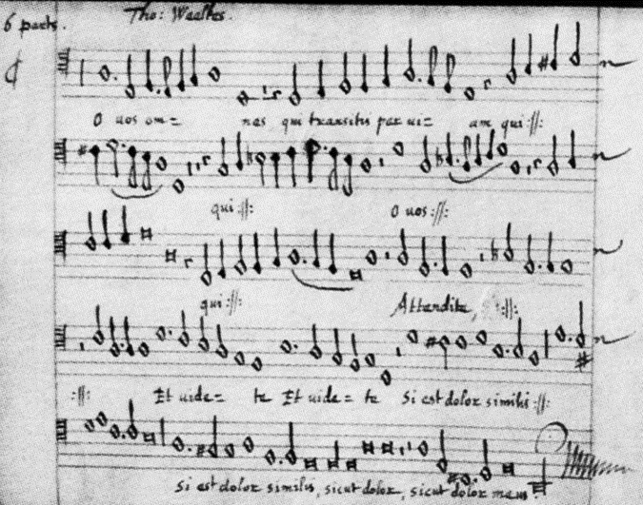
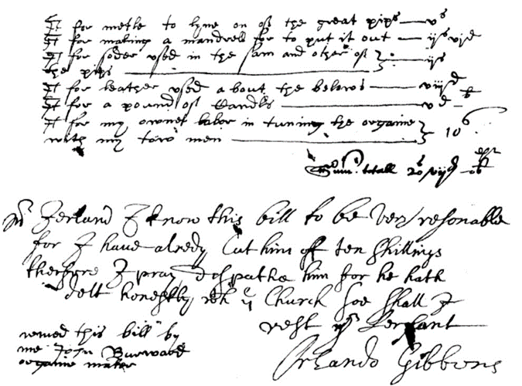
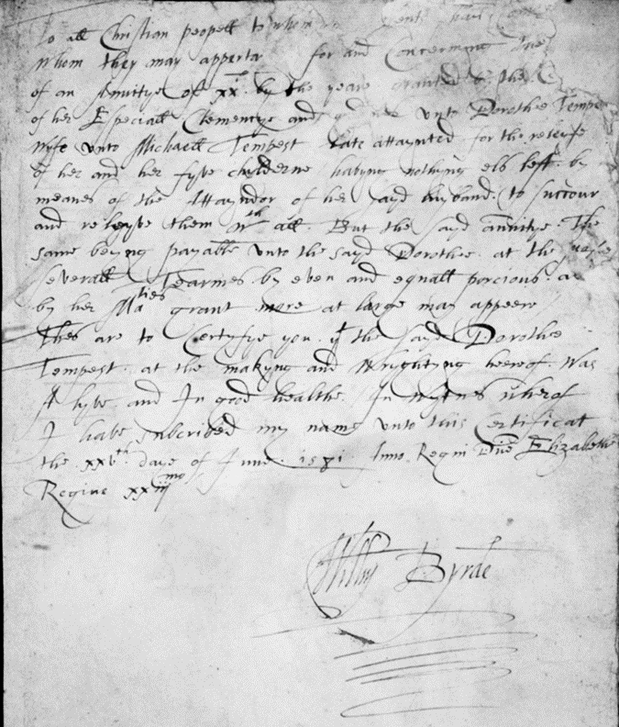
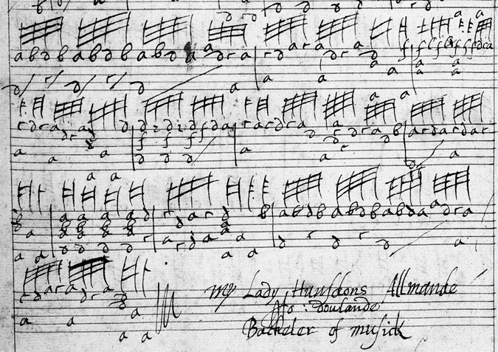
Byrd: Orlando Gibbons, John Dowland, Thomas WEELKES

Slide 12
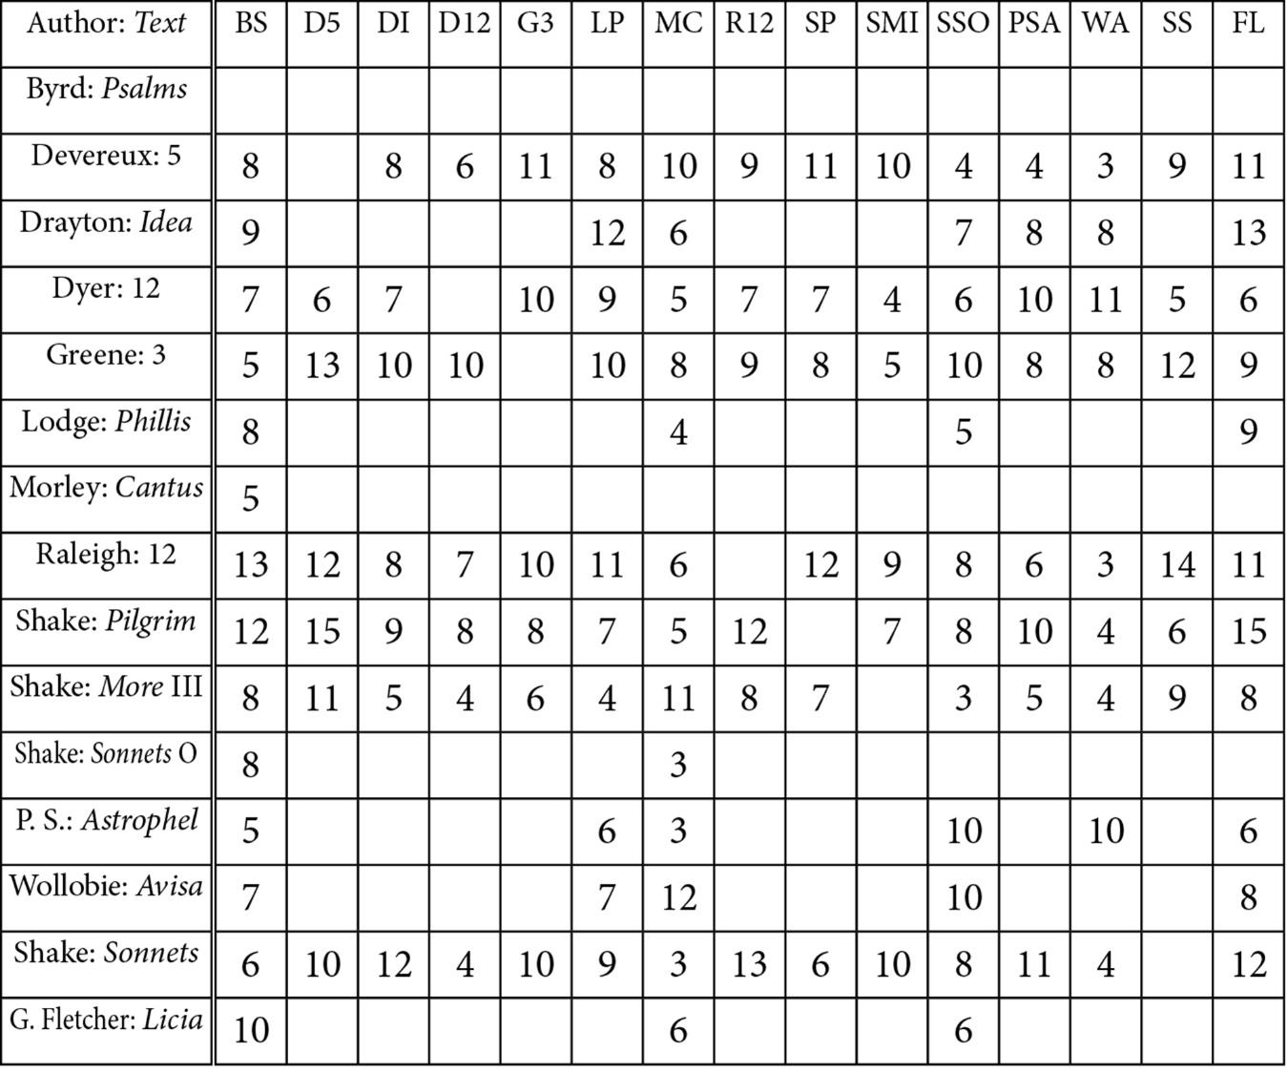
BYrd

Slide 13
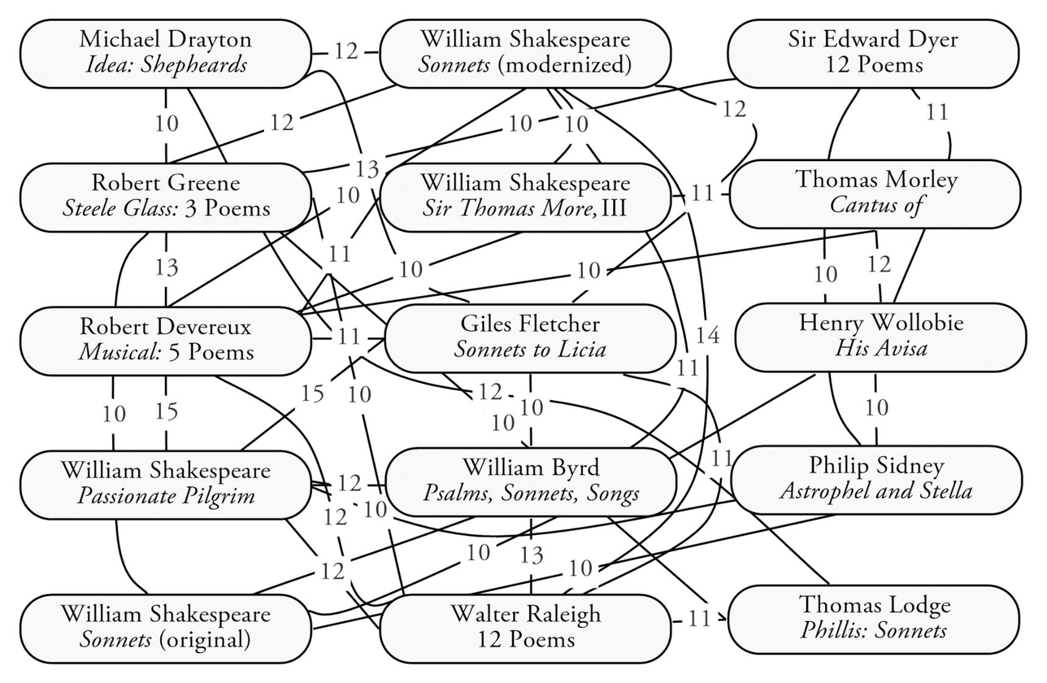
BYrd

Slide 14
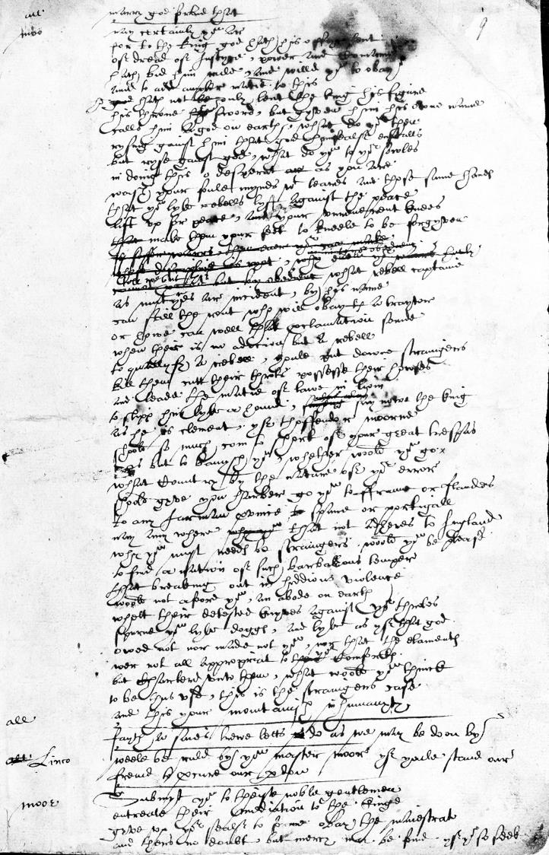
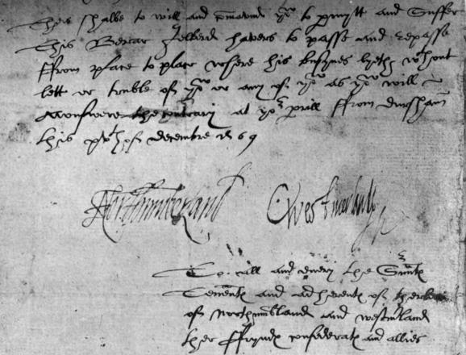
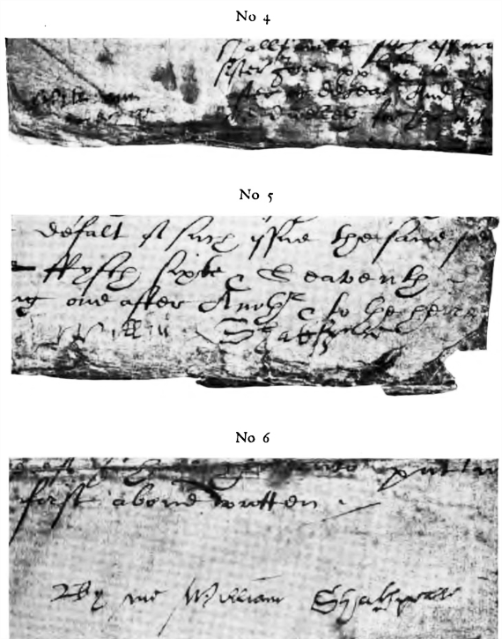
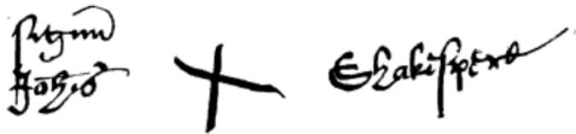
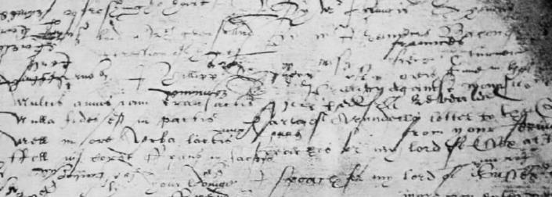
Percy: “Will Shakespeare” “Northumberland” “John Shakespeare” Northumberland MS Sir Thomas More

Slide 15
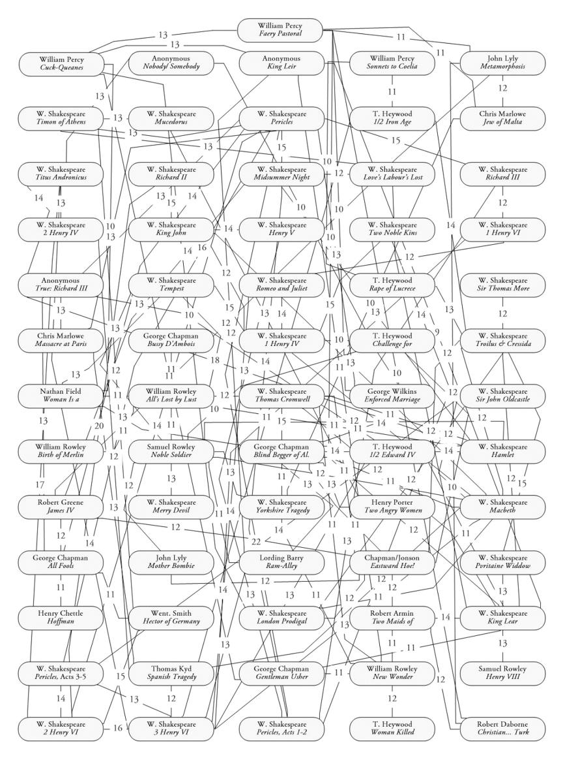
William Percy

Slide 16
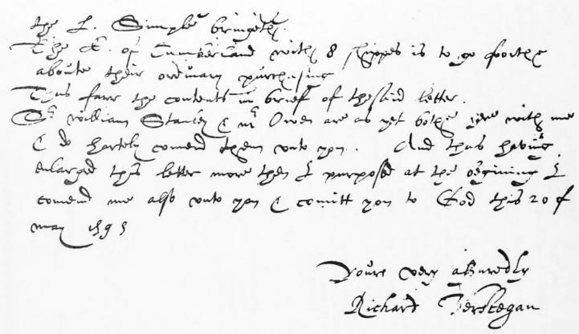
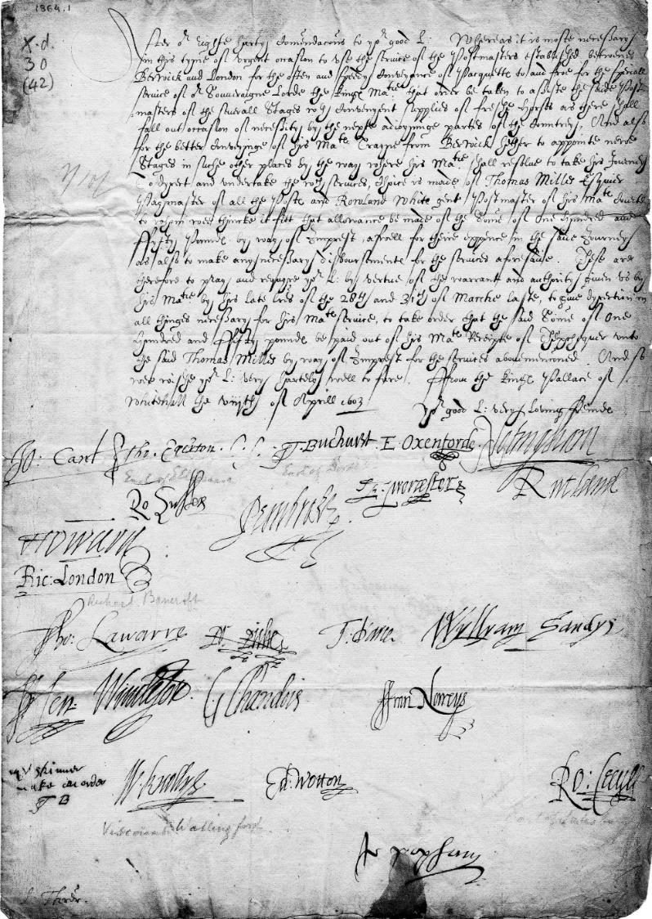
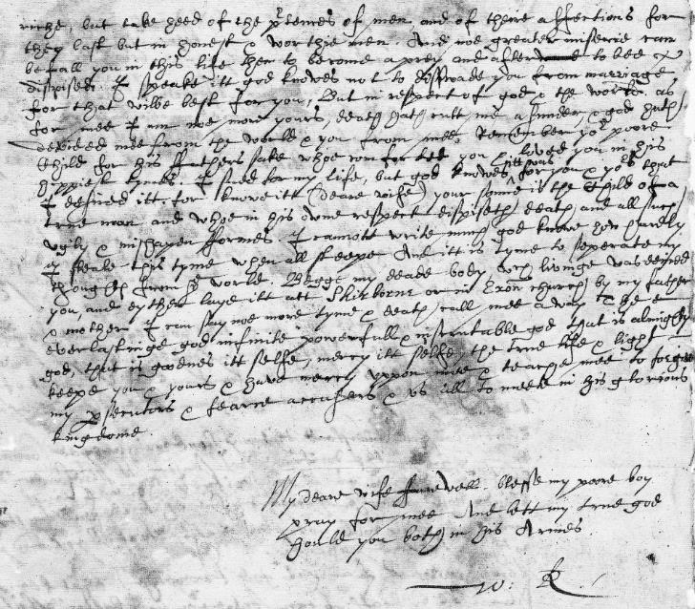
Richard Verstegan
vs
Walter
Raleigh
Vs
Privy
Council

Slide 17
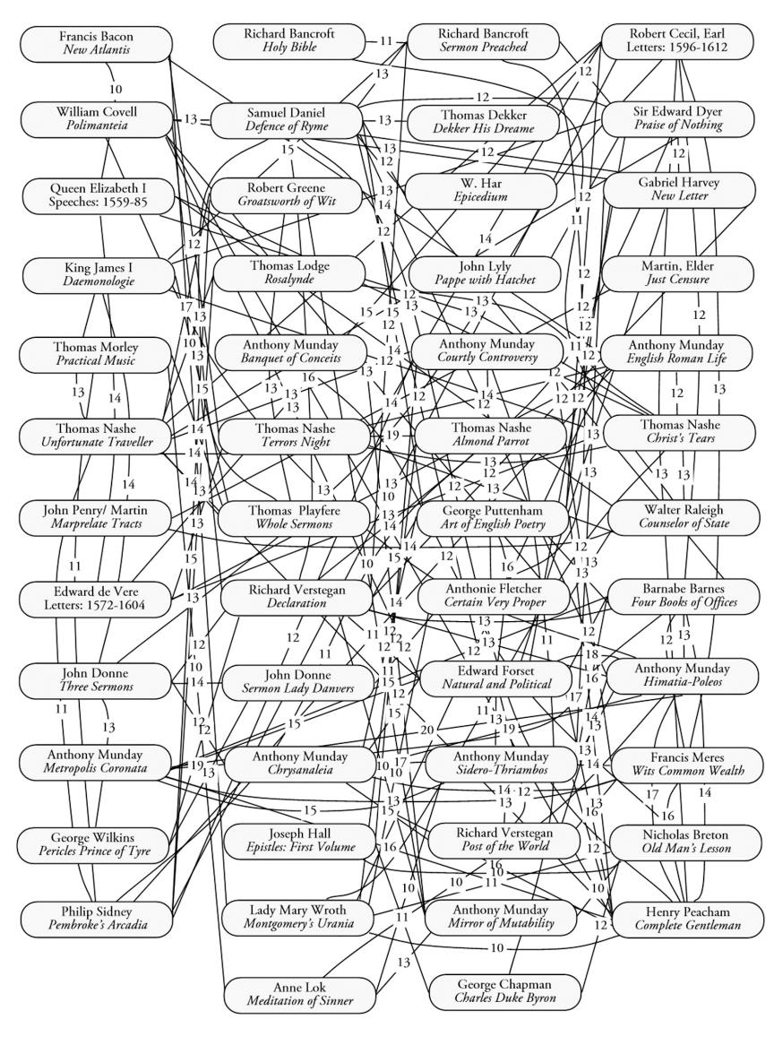
Richard Verstegan

Slide 18
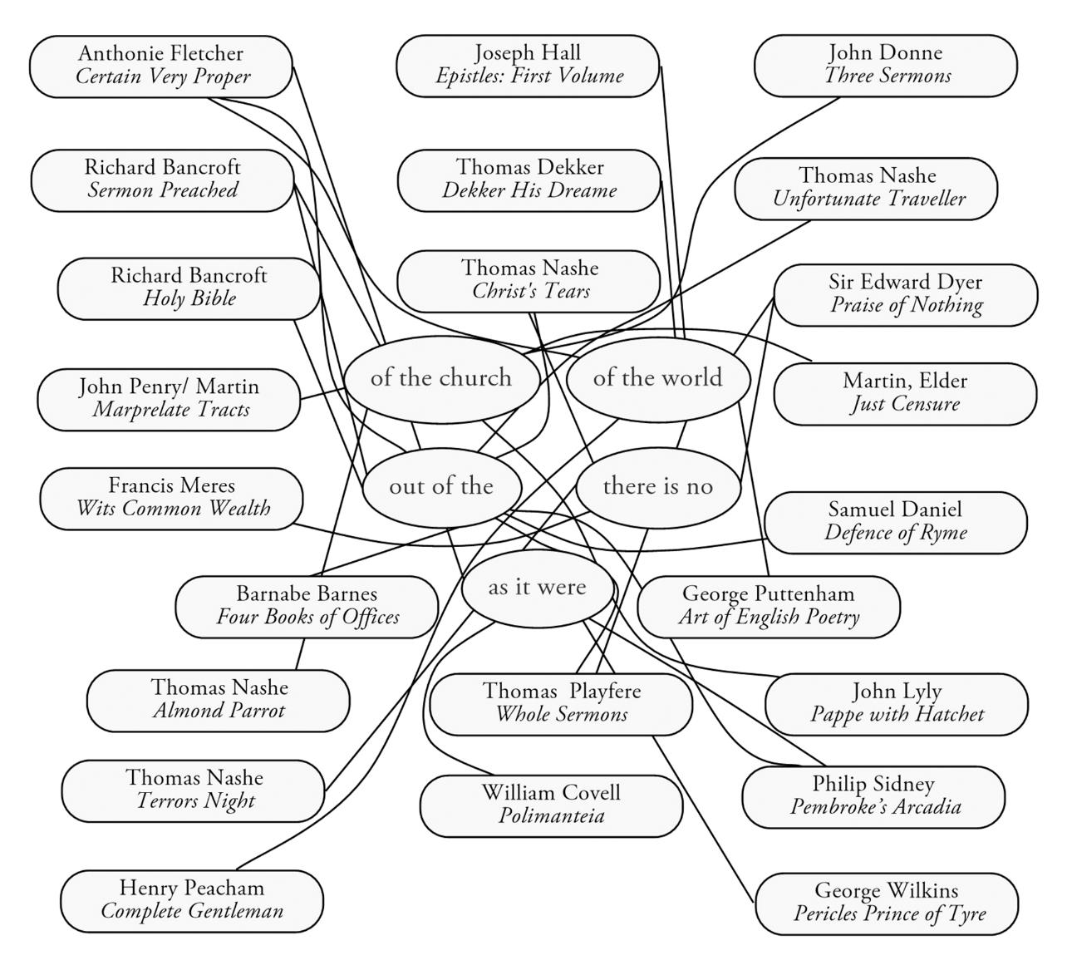
Richard Verstegan

Slide 19
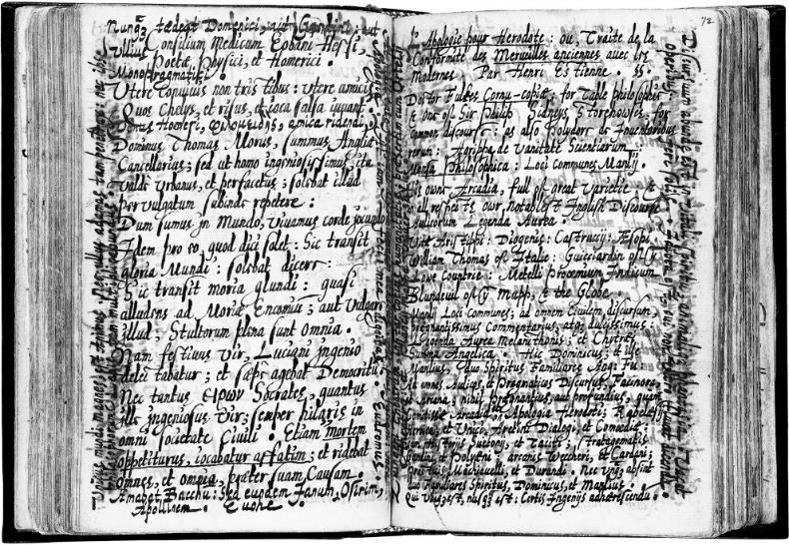
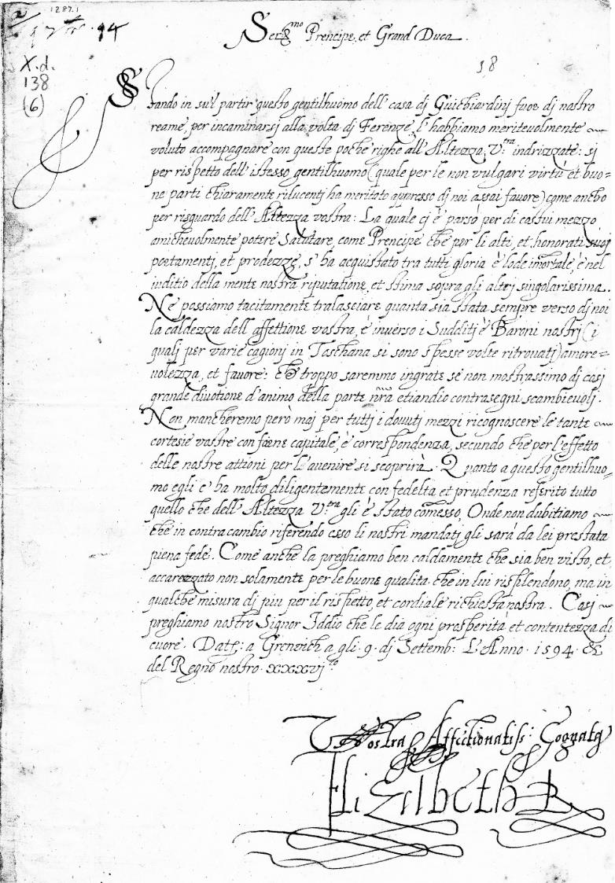
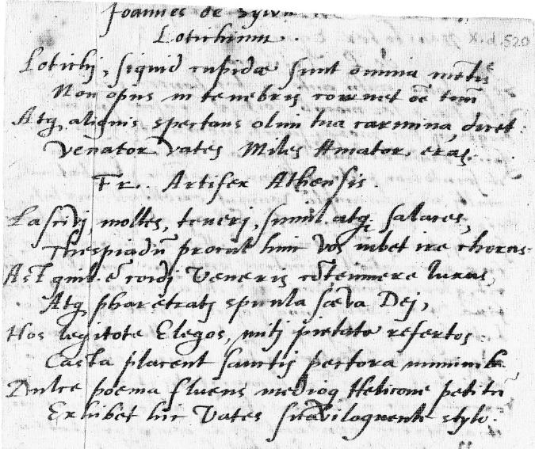
Gabriel Harvey
Vs.
Edmund
Spenser
Vs.
Queen
Elizabeth I

Slide 20
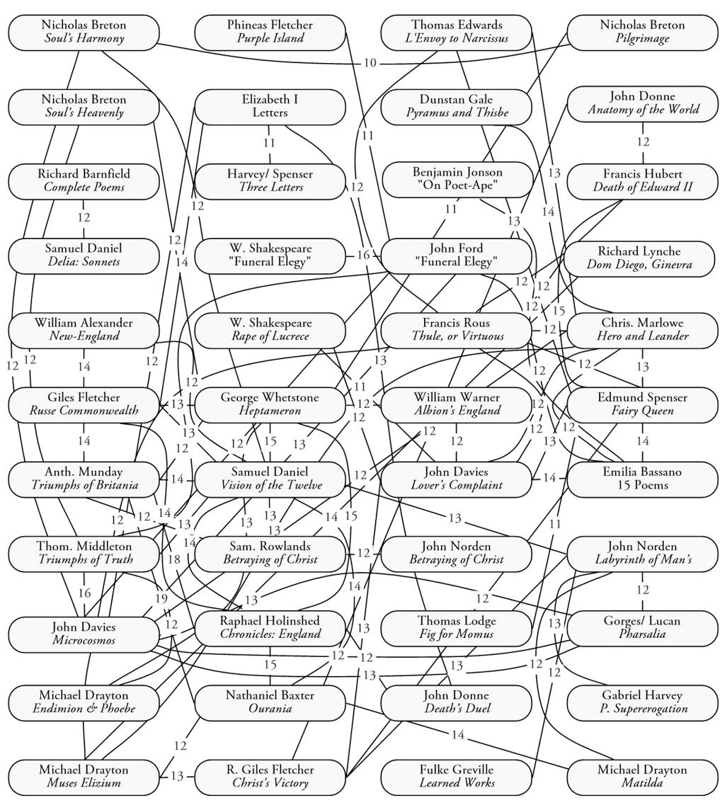
Gabriel Harvey

Slide 21
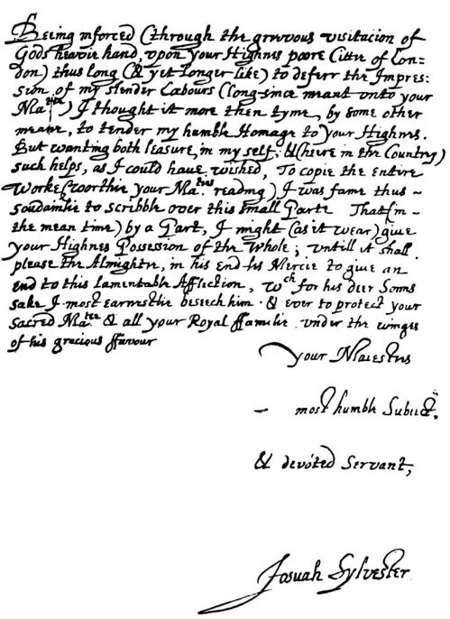
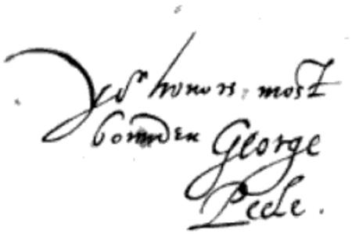
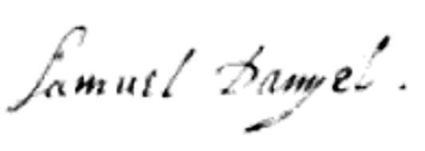
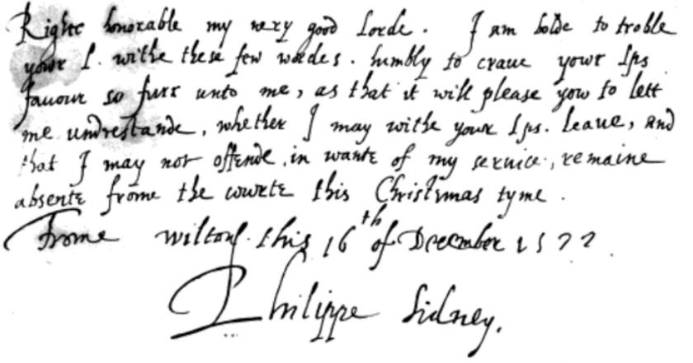
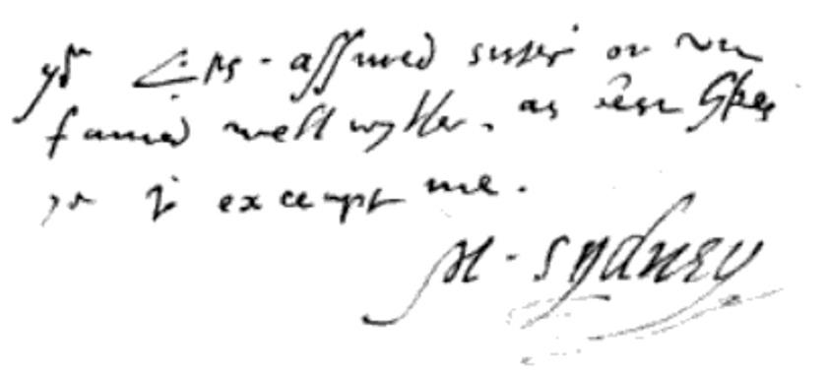
Josuah Sylvester George Peele Samuel Daniel Philip Sidney Mary Sidney

Slide 22
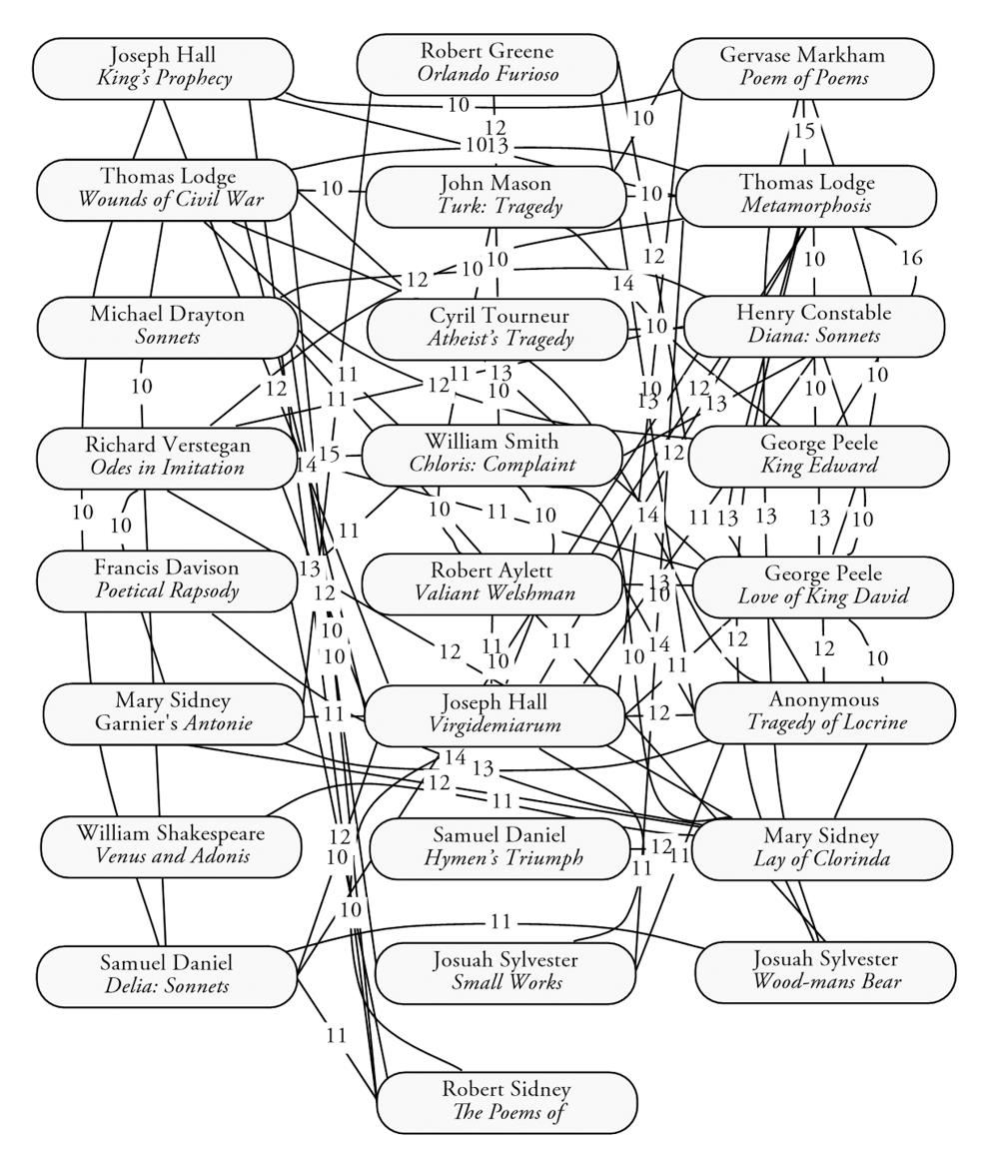
JoSuah Sylvester

Slide 23
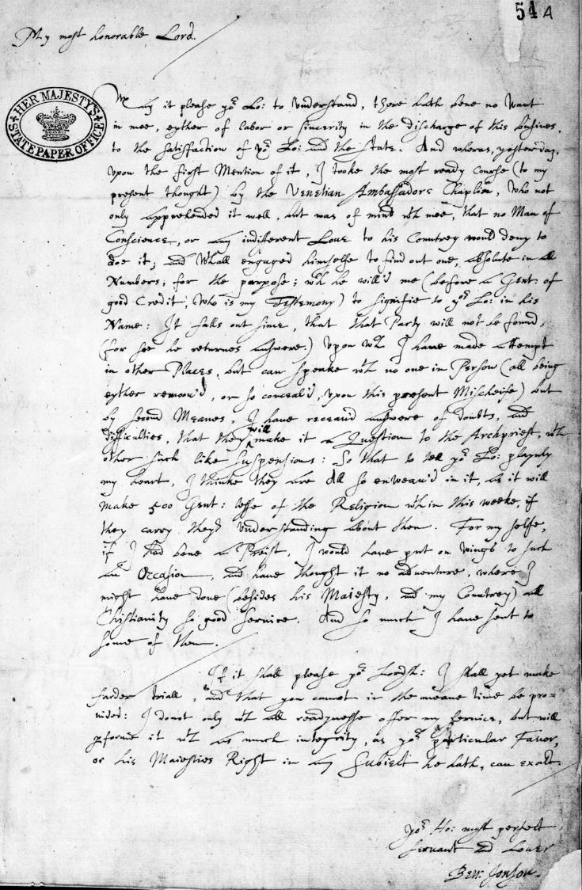
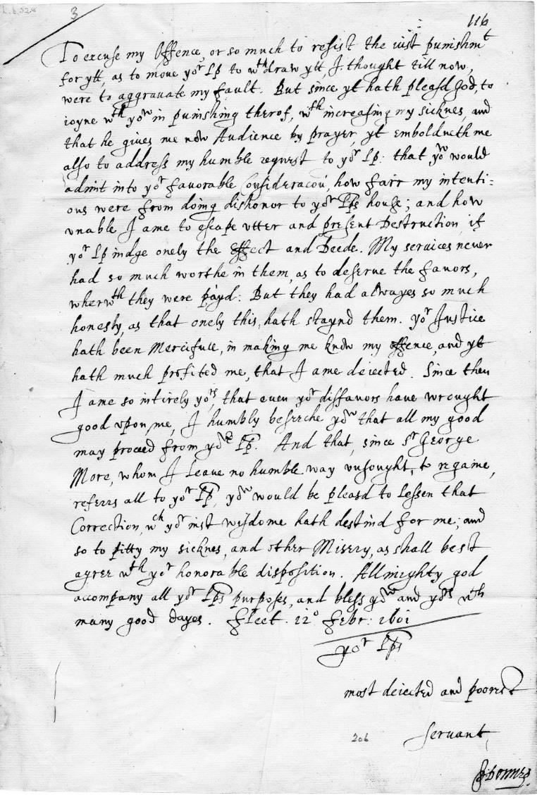
Ben Jonson
vs.
John
Donne

Slide 24
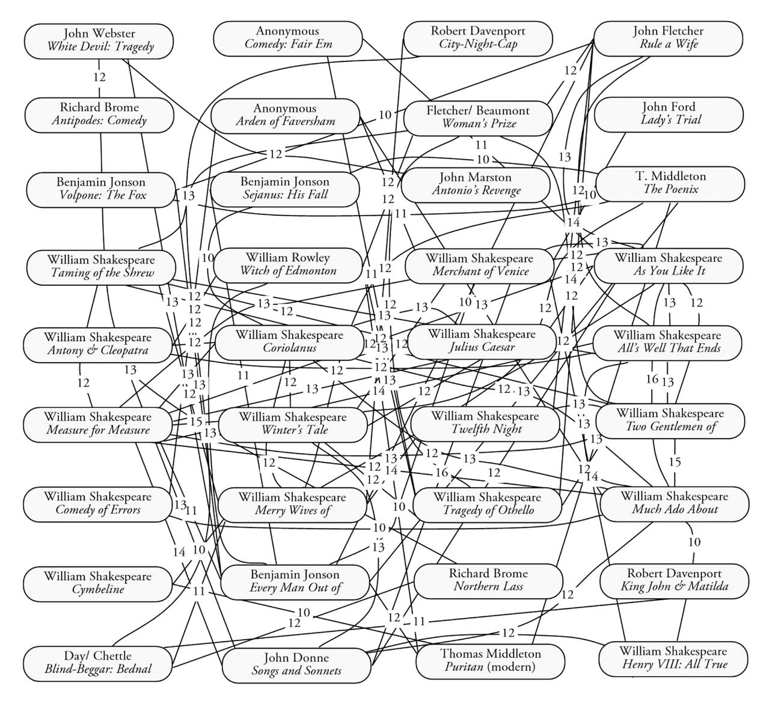
Ben JOnson

Slide 25

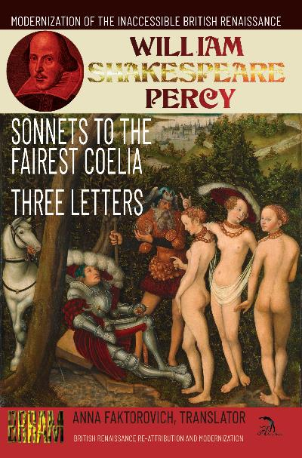
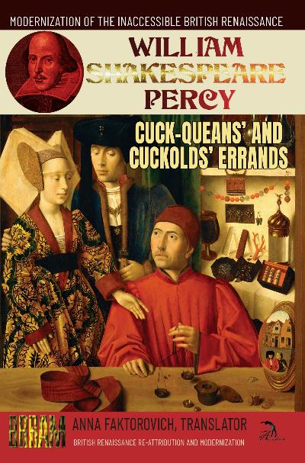
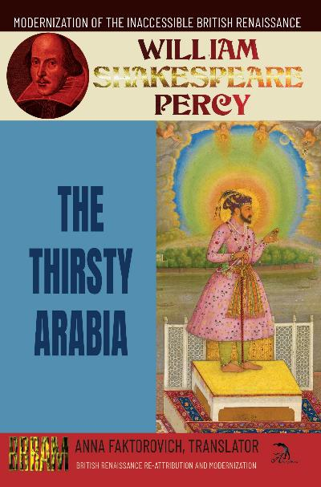
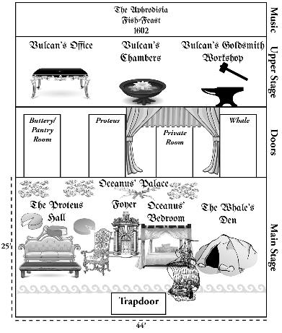
British Renaissance Re-Attribution and Modernization Series
Raw and Computed Data, Graphs, Handwriting Clusters:
https://github.com/faktorovich/Attribution

Slide 26

The Re-Attribution of the British Renaissance Corpus
The first accurate quantitative re-attribution of all central texts of the British Renaissance.
Describes and applies the first unbiased and accurate method of computational-linguistics authorial-attribution.
Covers 303 texts with 8,106,059 words, 123 authorial bylines, a range of genres, and a timespan between 1510 and 1662.
Includes helpful diagrams that visually show the quantitative-matches and the identical most-frequent phrases between the texts in each linguistic-signature-group.
Detailed chronologies for each of the six ghostwriters and the bylines they wrote under, including their dates of birth, death, publications, and other biographical markers that explain why each of them was the only logical attribution.

Slide 27

PART I: William Percy’s Self-Attributed texts Sonnets to the Fairest Coelia (1594) and Three Letters
The only actual collection of sonnets written by William Shakespeare Percy.
William Percy (1567?-1648) is the dominant tragedian behind the “William Shakespeare” pseudonym according to the computational-linguistic study in The Re-Attribution of the British Renaissance Corpus. Percy was a younger son of the assassinated 8th Earl of Northumberland and the brother of the imprisoned in the Tower 9th Earl.

Slide 28

The Cuck-Queans’ and Cuckolds’ Errands (1601)
An anti-warfare, anti-marriage, and pro-free-love closeted satire.
A single vengeful cuckold is tragic, whereas many cuck-queans and cuckolds running across England on their love-errands is satiric. The title of this play announces why it remained closeted across the Renaissance, as it trivializes adultery in a period that continued to see revenge-killings by cuckolds.

Slide 29
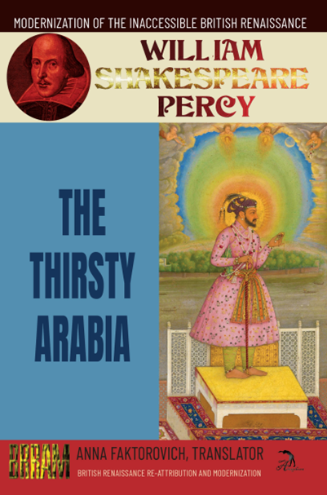
The Thirsty Arabia (1601)
A closeted first attempt to present the complexities and elegance of the Islamic faith and the prophet Muhammad on the English stage.
Thirsty Arabia was written over a century before the first English translation of the Qur’an was published. Despite this shortfall in primary sources about Islam, this comedy incorporates with unbiased research a wealth of theological and cultural details. Information flowed into Britain from Muslim countries alongside general trade in goods after Pope Pius V excommunicated Elizabeth I in 1570, but trade was halted shortly after this play was written in 1603. The narrative is launched when Muhammad declares he will destroy all mortals in Arabia for their sins in forty days with a drought.

Slide 30
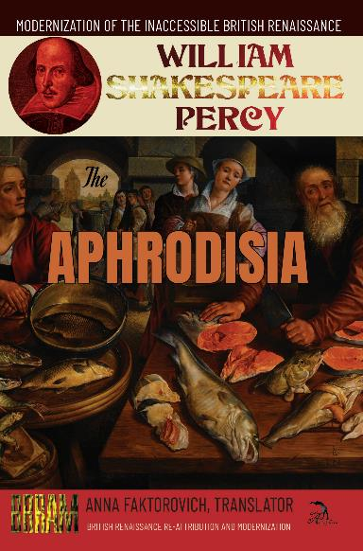
The Aphrodisia (1602)
A rare marinal about disguised identities and loves among the Greco-Roman deities under the Mediterranean Sea.
Percy described Aphrodisia as an experiment in a new genre he was inventing, the marinal, designed to contrast the pastoral set on land in the countryside. Beyond this setting, this comedy focuses on taking to an extreme the popular European trope of disguises by having most of the main characters reveal themselves to have an identity other than the one they present themselves as.

Slide 31
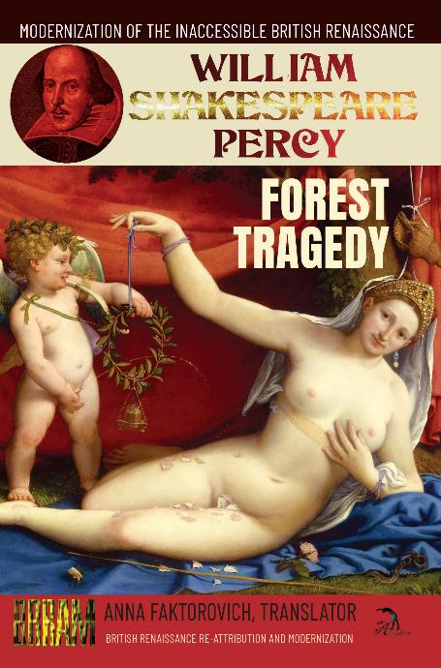
A Forest Tragedy in the Vacuum: Or, Cupid’s Sacrifice (1602)
A farcical satire about the Laws of Tragedy and irrational morality that presents a Vacuum of death.
The Forest Tragedy is the only text that Percy labeled as a “tragedy”, but kept closeted in his family archives, without successfully selling it to a publisher. As the dominant tragedian under the “Shakespeare”-byline, Percy was the master of this genre. After decades of practicing perfecting strict obedience to the Laws of Tragedy, in this experiment, Percy rebels against them and satirizes the “imbecility” behind formulaic rules, and particularly in the types of rules that governs this “cruel” genre. The resulting farce especially satirizes Percy’s “Shakespeare”-bylined Romeo and Juliet (1597), as well as other murder-suicide dramas described in “William Painter’s” The Palace of Pleasure (1575).

Slide 32
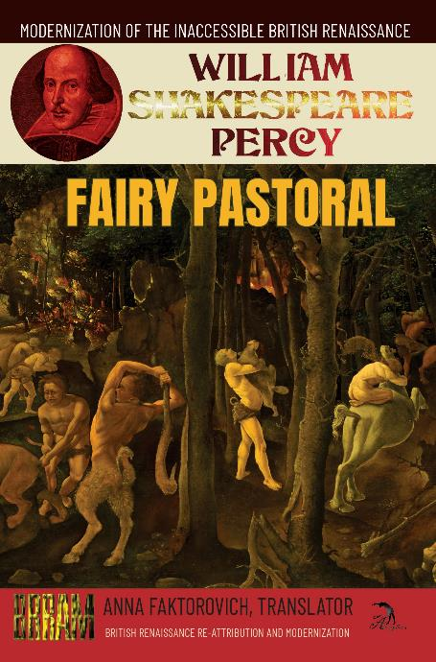
The Fairy Pastoral (1603)
A pastoral satire about homicidal women- and men-haters being forced into marriage.
A standard “Shakespearean” comedy takes a group of youths who are attracted to those who are not interested in them, and regroups them by the conclusion into neat pairings of three or four marriages. In contrast, Fairy Pastoral appears to have been censored because the men in the pairings are wooing their intended partners from the beginning, while the women are homicidally opposed to marriage and prove to the men how much they hate them during the plot, only for them all to be forced into four marriages that all of them are miserable in by the resolution. The setting is the Forest of Elvida inhabited by a kingdom of fairies.

Slide 33
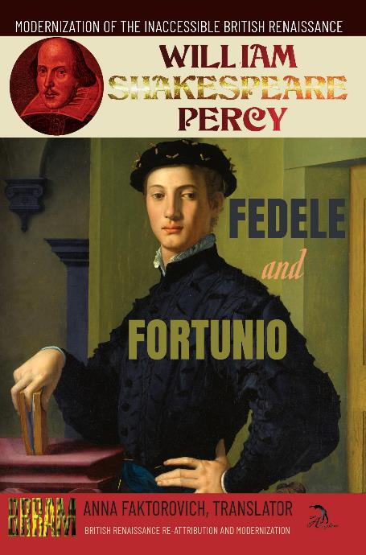
PART II: ATTRIBUTION MYSTERIES “A. M.’s” Fedele and Fortunio, the Two Italian Gentlemen (1585)
An adaptation of an Italian anti-comedy into an English formulaic-comedy.
Fedele and Fortunio is an exercise in adapting Luigi Pasqualigo’s Italian Il Fedele: Comedia del Clarissimo (1576) into an idealized version of British cultural purity. Pasqualigo had rebelled against preceding tropes of Italian comedy by showcasing murderous and wildly promiscuous and unfaithful ladies and gentlemen, and rebellious servants. Perhaps because Percy was desperate in his youth to create extremely proper content that would lead to him being invited to officially write for court revels, Percy re-wrote Pasqualigo’s innovations back into what this comedic plot was initially designed to be. A couple of virginal gentlemen and a couple of virginal ladies exchange love-interests as they realize they cannot attain their initial desires. Their eventual marriages are attained with mischievous help from a pretense-captain Crack-Stone, a spying Pedant who fakes being in love to appear manly, and the scientific and psychologically-manipulating magic of enchantress Medusa.

Slide 34
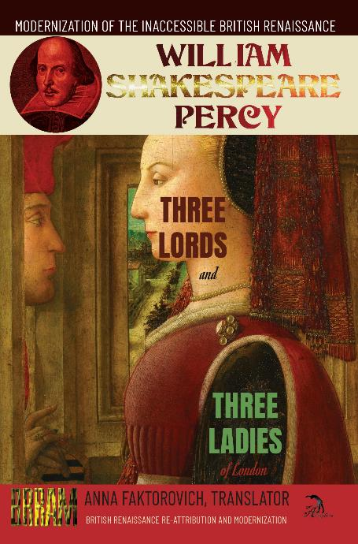
“Robert Wilson’s” Three Lords and Three Ladies of London (1590)
An allegorical morality comedy about criminality and the rivalries between London, Lincoln and Spain.
This play is an exercise by a young dramatist who is grappling with understanding philosophical and legal concepts by simplifying these into personifications. Three Lords of London (called Pleasure, Pomp and Policy) declare their superiority with puffing emblems and insist that they have an innate right to marry the three Ladies of London (Love, Lucre and Conscience). The Ladies have been imprisoned in the first part of this series (Three Ladies of London) for their sins, and Nemo has decided that he would only release them if precisely three suitors bid for all of their hands in marriage simultaneously. The Ladies are told to remain silent and to obey whoever is willing to marry them, or they would have to return to prison to be tortured by Sorrow.

Slide 35

The Anonymous Look Around You (1600)
The neglected actual first part of the Robin Hood series.
Both in terms of its plot and date of first-publication and performance, Look Around You is the first part of a trilogy that was followed by the two famous Robin Hood plays, Downfall of Robert and Death of Robert Earl of Huntington. The latter two are tragedies that have been previously falsely attributed to “Anthony Monday”, while Look is a comedy that has remained unattributed since its anonymous release. Censors might have neglected to connect Look to the others because in it, Robin Hood (Earl of Huntington) spends most of the play cross-dressing as Lady Faukenbridge, and being wooed on a balcony by Prince Richard. Meanwhile, Skink wears a myriad of disguises to escape Old King Henry’s wrath over the Queen hiring Skink to assassinate the King’s lover, Rosamund.

Slide 36

Look Around You

Slide 37

“William Shakespeare’s” Hamlet (First Quarto: 1603)
The censored satirical or “bad” version of the “Shakespeare” classic that features a homosexual affair between Hamlet and Horatio, and Ofelia’s deflowering to feign heterosexual normalcy.
The standard summary of Hamlet describes it as a “tragedy” about a “mad” or “tormented” Prince of Denmark, who follows the solicitation of the Ghost of his assassinated father to revenge-murder his incestuous and homicidal uncle Claudius. The commentary that accompanies this never-before fully-modernized First Quarto of Hamlet explains how it was initially designed to be a satire that diverged from Saxo Grammaticus’ Danish History where Amleth pretends to be mad not only to execute revenge but also to successfully win the crown from his uncle. The First Quarto subtracts any desire for the crown from Hamlet, and instead subversively explains that Hamlet is motivated to feign madness and to deflower Ofelia to disguise his outlawed homosexual love for Horatio.

Slide 38

Nobody and Somebody (1606)
A comedy that juxtaposes fame with anonymity, and tyrannical abuse with fair governance.
The rapid succession of monarchs across Nobody and Somebody satirizes the standard plots of “Shakespearean” histories that end with the overthrow or death of the preceding tyrannical monarch, and suggest hope that the next monarch will be better, before this hope is dispelled in the next tragic history, as is the case with the chronological series of Edward III, Richard II, and 1 Henry IV. Nobody is set in 85-60 BC, or just before the Roman invasion of the British Isles. The plot opens with two Court advisors, Cornwall and Marcian, scheming to overthrow their corrupt King Archigallo who unfairly confiscates land to grant it to Lord Sycophant and names a common Wench as his Queen.

Slide 39

“William Cavendish’s” Captain Underwit (1649)
A country comedy about the absurdly corrupt purchases of military titles.
Captain Underwit has succeeded in becoming a “paper” Captain by bribing the Lieutenant with favors and a below-value land-purchase. Underwit then sends his servant Thomas to purchase books to prepare him to actually carry out military duties, but Thomas instead purchases the “Shakespeare” Folio, and other impractical or irrelevant books in a manner that echoes Don Quixote’s belief he could imitate the actions of knights in romance novels. Meanwhile, Underwit withdraws from London into his father-in-law Sir Richard’s country estate. Underwit hires Captain Sackburie to build his military acumen, but Sackburie only has him perform a few military dances before they escape to drink at a tavern.

Slide 40

Ben Jonson’s “Cavendish’s” The Variety (1649)
Benjamin Jonson (1572-1637) is the dominant comedian behind the “William Shakespeare” pseudonym according to BRRAM’s computational-linguistic study. Jonson published several famous plays under his own byline, but arrests on libel charges drove him to predominantly use pseudonyms in his frankest satirizing plays.
A fragmentary comedy about the corruption of the judicial and monarchical systems in charge of granting aristocratic titles based on appearance instead of merit.
The historical introduction to the types of dance-instructors Variety is satirizing is assisted by the translation from French into English of fragments from Apologie de la Danse or Apology for the Dance by “Par F. de Lauze” (1623).

Slide 41

Gabriel Harvey’s “Samuel Brandon’s” The Tragicomedy of the Virtuous Octavia (1598)
Gabriel Harvey (1552?-1631) is the Workshop’s dominant epic poet behind greats such as the “Edmund Spenser”-bylined Fairy Queen, according to BRRAM’s computational-linguistics. Harvey served as a Rhetoric Professor at Cambridge, before learning merit was insufficient.
The first English self-labeled “tragicomedy” about Octavia’s failed attempts to win back her inconstant husband, Antony, from his Egyptian lover, Cleopatra, and to prevent her brother, Octavius, from waging retaliatory war on Antony and Cleopatra.
This volume presents overwhelming evidence for the re-attribution of the “Samuell Brandon”-bylined The Virtuous Octavia (1598) to Gabriel Harvey. Introductory content includes three letters exchanged between William Byrd and Harvey while both were teaching at Cambridge, the “Octavia to Anthony” poetic epistle from the Arundel Harington Manuscript, and fragments from Plutarch’s “Mark Antony” chapter.

Slide 42

William Byrd A Comparative Study of Byrd Songs
William Byrd (1540?-1623) is the Workshop’s versifying musicologist, with an official music industry monopoly. He worked as the Chapel Royal’s Organist, while ghostwriting for other musicians to elevate their careers.
A comparative anthology of all of the variedly-bylined texts in William Byrd’s linguistic-group, with scholarly introductions that solve previously impenetrable literary mysteries, including the authorship of “Shakespeare’s” Passionate Pilgrim and Sonnets, as well as the attribution of otherwise bylined texts from “Spenser”, “Dyer” “Raleigh” and others.

Slide 43

PART III: THE SELF-ATTRIBUTED TEXTS OF THE GHOSTS Richard Verstegan’s A Restitution for Decayed Intelligence in Antiquities (1605)
Richard Verstegan (1550?-1640) is the Workshop’s lead forger, who became a licensed goldsmith when he was dismissed from Oxford and eventually exiled over his Catholicism, using this to establishing a Catholic publishing monopoly, while ghostwriting for all sides, with achievements that include the King James Bible.
The launch of Britain’s “Anglo-Saxon” origin-myth and the first Old English etymological dictionary.
This is the only book in human history that presents a confessional description of criminal forgery that fraudulently introduced the legendary version of British history that continues to be repeated in modern textbooks.

Slide 44

Gabriel Harvey’s Smith: Or, The Tears of the Muses (1578)
A poetic satire of ghostwriters being hired to write puffery of and by patrons and sponsors, who pay to gain immortal fame for being “great”, while failing to perform any work to deserve any praise. This is the first translation of this text out of Latin into English.
This volume shows the similarities across Gabriel Harvey’s poetic canon stretching from his critically-ignored self-attributed Smith (1578), his famous “Edmund Spenser”-bylined Fairy Queen (1590), and his semi-recognized “Samuel Brandon”-bylined Virtuous Octavia (1598). This close analysis of Smith is essential for explaining all of Harvey’s multi-bylined output because Smith is an extensive confession about Harvey’s ghostwriting process.

Slide 45

Josuah Sylvester’s Job Triumphant in His Trial and The Woodman’s Bear (1620)
Josuah Sylvester (1563-1618) is behind classics such as the first text misassigned to “William Shakespeare”, Venus and Adonis, according to BRRAM’s computational-linguistics. Sylvester was Prince Henry’s Court Poet, but his self-attributed works are ignored due to his open Judaism.
The first verse English translation of the Book of Job, and a fantasy epic poem about the woeful love between the Woodman and the Bear.
Computational, handwriting, and other types of evidence proves that Josuah Sylvester ghostwrote famous dramas and poetry, including the first “William Shakespeare”-bylined book Venus and Adonis (1593), the “Robert Greene”-bylined Orlando Furioso (1594) and the two “Mary Sidney”-assigned translations of Antonie (1592) and Clorinda (1595).

